Slide 1
Azure Functions

Slide 2
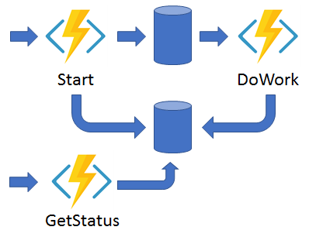
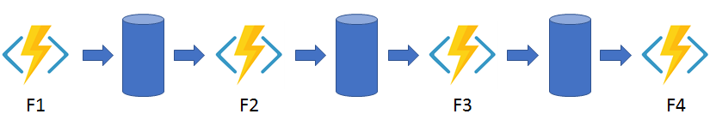
Durable Functions
Durable Functions: an extension of Azure Functions that lets you write stateful functions in a serverless compute environment.
The extension lets you define stateful workflows by writing orchestrator functions (OrchestrationTrigger) and stateful entities by writing entity functions using the Azure Functions programming model.
You can use Orchestrator functions (OrchestrationTrigger) with Trigger function (e.g., BlobTrigger) & Activity Function (ActivityTrigger) to create a Function Chaining pattern
Behind the scenes, the extension manages state, checkpoints, and restarts for you, allowing you to focus on your business logic.
Function Chaining

Slide 3






Azure Durable Functions – Chaining example
Trigger event
Starts orchestration
Key vault Reference for secrets
Managed Identity
Blob Storage
Trigger (BlobTrigger)
Orchestrator function
Azure Key Vault
Function Chaining
SendMessageToServiceBus-F1
SendNotificationEmail-F2
. . . _ F(n)
Azure Service Bus
Azure Communication Service

